Slide 1
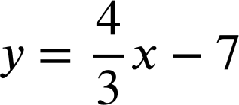
Using the fx-CG50 for number and algebra
Task A: Solving equations graphically
1) Use your calculator to solve these pairs of simultaneous equations.
a)
y = x − 3
y = 3x + 6
b)
6y − x = 14
x + 3y = 13
2) For each pair of simultaneous equations, write down what your calculator says when you try to solve them graphically. Why do you think the calculator gives this output?
a)
35x − 7y = 63
y = 5x + 1
b)
3x + 4y = 7

Slide 2
Using the fx-CG50 for number and algebra
c)
25x − 5y + 5 = 0
y = 5x + 1
3) Use your calculator to estimate the solutions to this pair of simultaneous equations to 3 d.p.
y = 3x − x²
y = 1.7 − 0.8x
Task B: Solving equations numerically
1) Solve the following pairs of simultaneous equations using your calculator.
a) b)
2a + 3b = 1
2b + a = 8
−a + 4b = 8
2b + 3 = 7a

Slide 3
Using the fx-CG50 for number and algebra
2) Calculate the solutions to these quadratic equations.
a) −x² − 8x + 20 = 0
b) x² + 8x − 19 = 0
c) x² + 6x + 8 = 3
d) 5x² − x + 5 = 3x² − 10x − 2
Mathematics in Education and Industry
v2.5

